Slide 1
IT 101 Computer Fundamentals
Mike Yeager
mikeyeager@unm.edu

Slide 2
Introduction to the Cloud and Other Programming Languages
Review
What is the Cloud?
Infrastructure As A Service (IAAS)
Platform As A Service (PAAS)
Software As A Service (SAAS)
Other Programming Languages
Java
Python
C++
C#

Slide 3
Review

Slide 4
What is the Cloud?
Computer and Software resources that can be managed by anyone from anywhere.

Slide 5
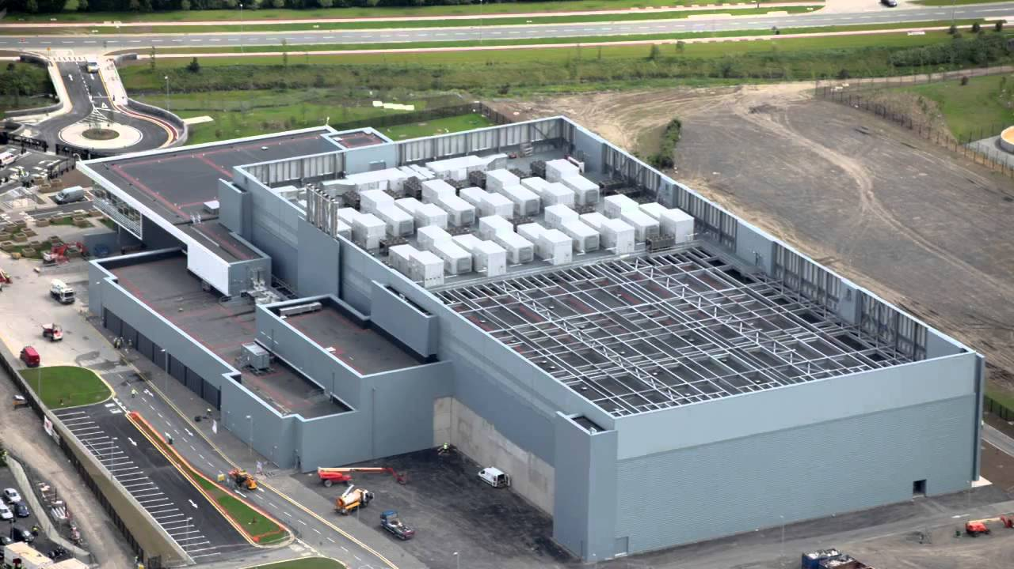

Slide 6
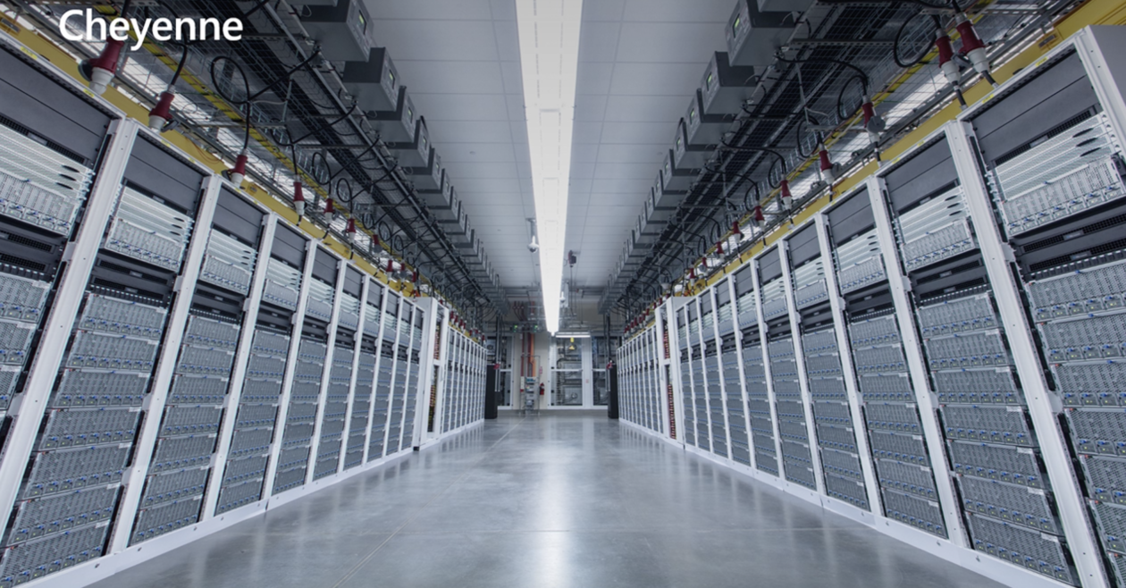
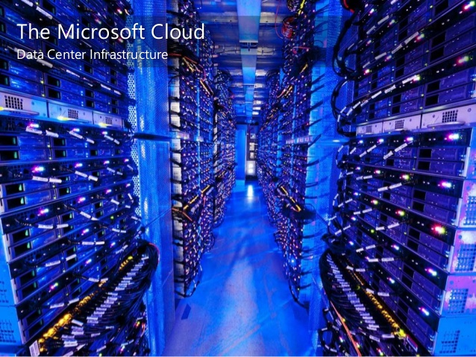

Slide 7
Infrastructure As A Service (IAAS)
Virtual Machines
Virtual Networks
Hardware for rent

Slide 8
Platform As A Service (PAAS)
Complex applications to integrate for rent
Web services
Database services
Artificial Intelligence services
Storage services
Queueing services
Etc., etc., etc.

Slide 9
Software As A Service
Software for rent
Office 365 / Google
Accounting software
Customer Relationship Management (CRM) software
Custom systems for any business or person

Slide 10
Other Programming Languages
Java – Created by Oracle. Now considered somewhat old school, but one of the most used languages in business.
Python – It comes installed free on just about every Mac and Linux machine and can be installed for free on Windows machines. Powerful and making a comeback in areas such as Machine Learning (ML), an area of AI.
C++ - An “Object Oriented” version of C. A very low level language. Extremely good performance and extremely versatile. Difficult language, more suited to areas where performance is needed than business applications.

Slide 11
Other Programming Languages C#
Pronounced “C Sharp”. Developed by Microsoft as the premier .NET language. Very popular for building all kinds of business applications from web to desktop to mobile to server applications.

